Slide 1

Skill Progress Analytics with Personalized Learning Path Recommendation Engine
Course Name :Java Programming
Course Code :CSA0925
By
S. Dharanish(192472152)
P. Jeevan Kumar(192472082)
Akileshwaran A(192511354)
Guided by
Dr. Sivasankar C

Slide 2


INTRODUCTION
Skill Progress Analytics with Personalized Learning Path Recommendation Engine is designed to analyze and track students’ learning progress.
The system collects quiz scores, completed courses, and learning activities to evaluate student performance.
It identifies the student’s strengths and weak areas through skill analysis.
Based on the analysis, the system provides personalized learning paths, course/topic recommendations, and improvement suggestions.
The system presents the results through a dashboard and reports, helping students understand their progress and plan their learning effectively

Slide 3
Problem Statement
Students often lack a clear understanding of their learning progress and skill level across different courses and topics.
Existing learning systems may provide course content but do not effectively identify individual strengths and weak areas based on performance.
Students may find it difficult to decide which course or topic to learn next, leading to an unstructured learning process.
There is a need for a system that can analyze quiz scores, completed courses, and learning activities to determine student progress.
Therefore, the proposed system aims to provide personalized learning paths and recommendations based on each student's progress and skill analysis.

Slide 4
OBJECTIVES
To track student learning progress based on quiz scores, completed courses, and learning activities.
To analyze student skills and identify their strengths and weak areas.
To calculate and evaluate overall learning performance for each student.
To generate personalized learning paths based on individual performance and skill gaps.
To recommend suitable courses and topics and provide progress reports through a dashboard.

Slide 5
EXISTING SYSTEM VS PROPOSED SYSTEM
Existing System | Proposed System
Fixed or standard learning paths | Personalized learning paths
Limited student progress analysis | Continuous progress tracking
Difficult to identify weak areas | Identifies strengths and weak areas
Generic course recommendations | Performance-based recommendations
Limited integrated reporting | Dashboard and personalized reports

Slide 6
Requirements
Requirements
Functional Requirements
User Login
Registration
Course Management
Progress Tracking
Recommendation Engine
Reports
Non-Functional Requirements
Security
Reliability
Scalability
Performance
Usability
Hardware
Intel i5/i7 Processor
8GB RAM
256GB SSD
Software
Java
MySQL
JDBC
NetBeans / Eclipse
Windows 10/11
Dataset/APIs
Student learning records
Quiz scores
Course completion data

Slide 7
LITERATURE SURVEY
S.No | Author Names | Year | Research Problem | Tools / Techniques Used | Research Gap
1 | Joseph et al. | 2022 | Fixed paths ignore individual learning styles. | Learning Analytics, Learning Style Model | Limited dynamic personalization
2 | Raj & Renumol | 2022 | Learning paths need real-time adaptation. | Real-Time Learning Analytics | Limited continuous learner-state adaptation
3 | Diao et al. | 2022 | Students need recommendations for weak concepts. | Weak Concept Mining | Limited integration with overall progress analytics
4 | Zhang et al. | 2023 | Difficult to select suitable resources from large e-learning content. | Knowledge Graph, GCN | Limited dynamic skill-based recommendation
5 | Gu | 2025 | Fixed paths do not suit different learner abilities. | Graph Attention, Deep RL | High complexity and data requirements

Slide 8
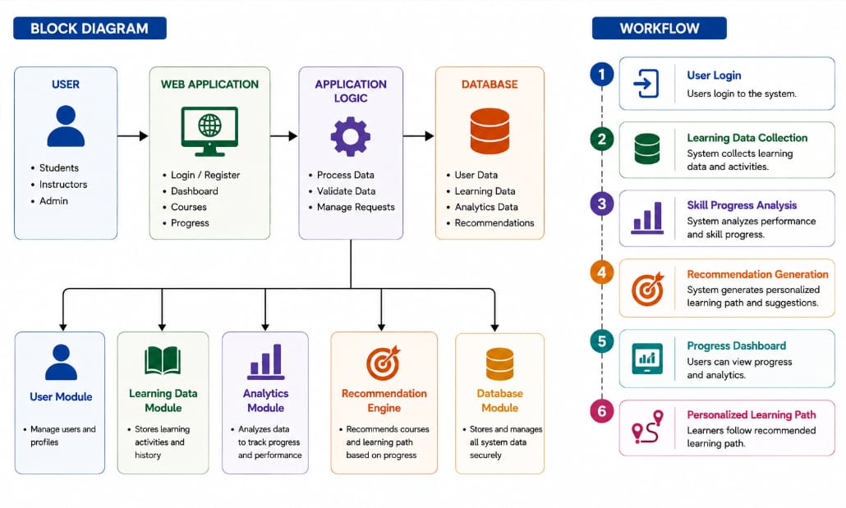
SYSTEM ARCHITECTURE

Slide 9
MODULE DESIGN
1. User & Course Management Module
Student Registration: Allows new students to create their accounts.
Login Authentication: Validates student login credentials.
Course Management: Manages available courses and course information.
Learning Activity Management: Maintains students’ learning activities.
Data Storage: Stores student, login, course, and learning-related information.

Slide 10
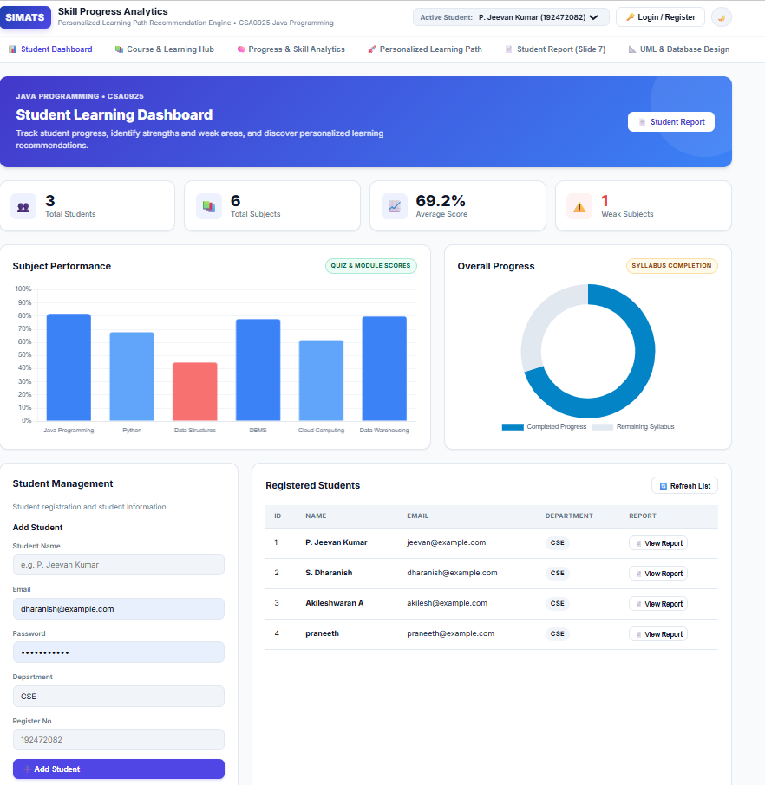
MODULE DESIGN

Slide 11
Module 2: Progress & Skill Analytics
Records student quiz scores to evaluate performance.
Tracks completed courses and learning activities.
Calculates the overall learning progress of each student.
Analyzes student skills based on their performance.
Identifies the strengths of each student.
Identifies weak areas that require improvement.
Generates progress and skill analysis results.

Slide 12
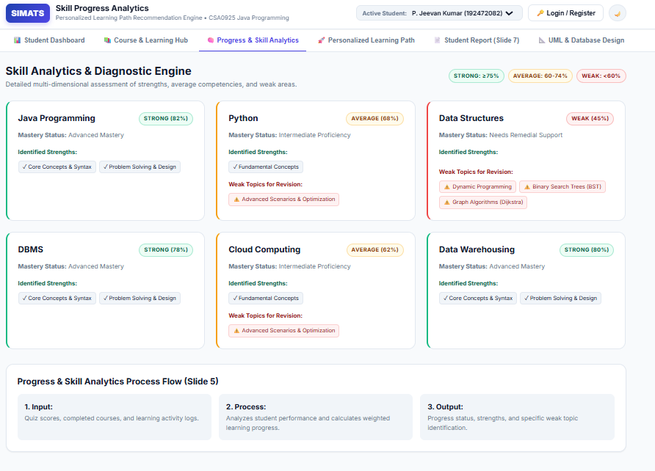
MODULE DESIGN

Slide 13
3. Recommendation & Dashboard Module
Generates personalized learning paths based on student performance.
Recommends suitable courses and topics for each student.
Provides suggestions to improve identified weak areas.
Displays student progress through a dashboard.
Generates personalized progress and skill reports.

Slide 14
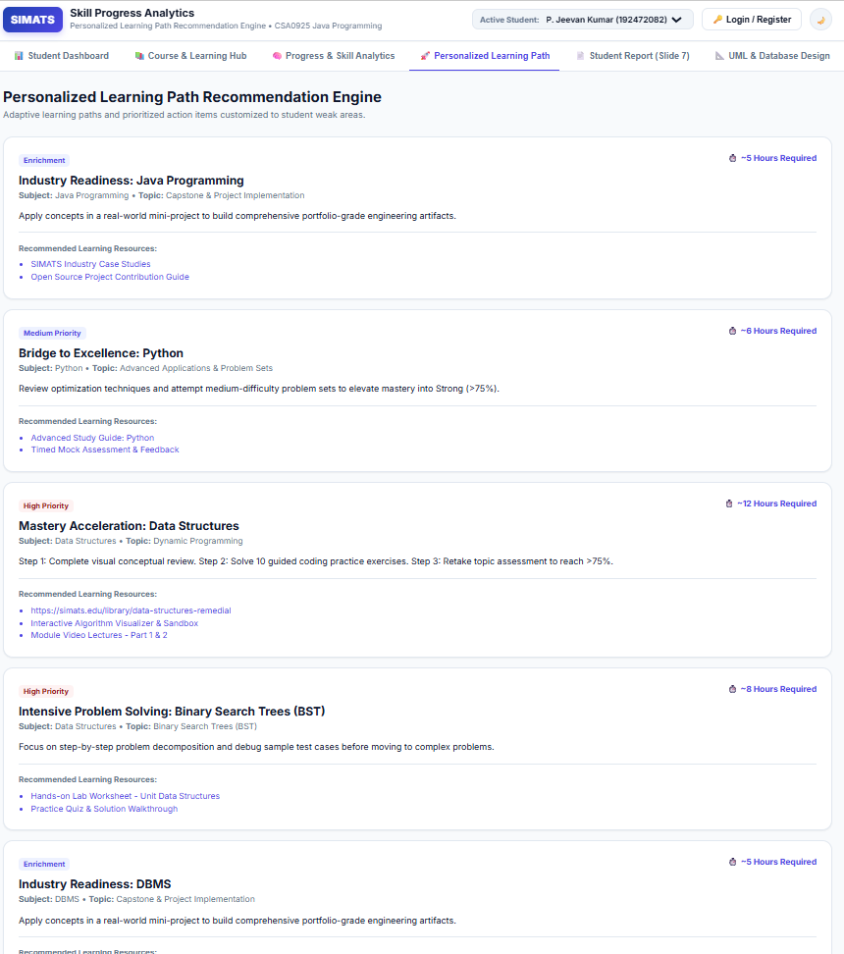
MODULE DESIGN

Slide 15
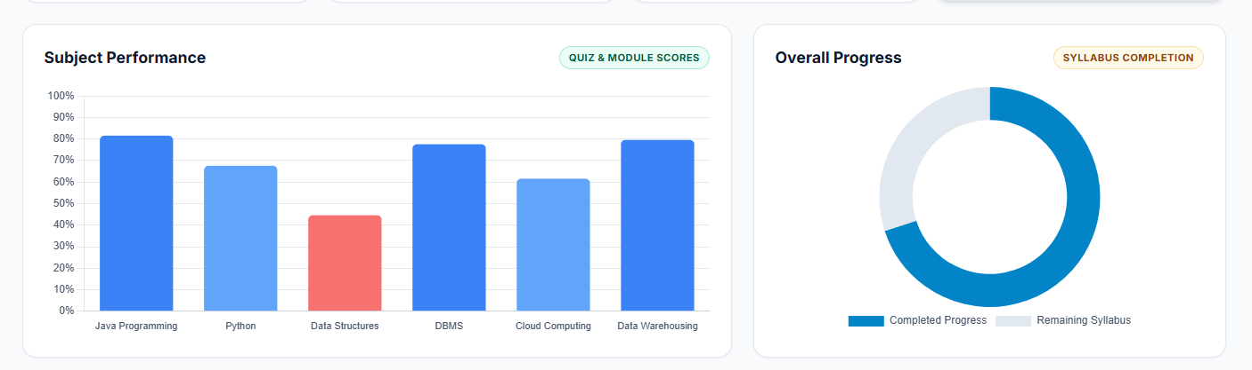
RESULT AND PERFORMANCE ANALYSIS

Slide 16
PROJECT HOSTING AND DEPLOYMENT
The project source code is maintained and version-controlled using GitHub.
The backend application is connected to GitHub for deployment and source-code management.
The backend is hosted on Render, providing a publicly accessible web service.
GitHub changes can be integrated with Render to build and deploy updated versions of the backend.
This setup provides a simple and reliable process for code management, backend hosting, and deployment.

Slide 17
CONCLUSION
The system successfully tracks and analyzes student learning progress.
It identifies student strengths and weak areas through performance analysis.
Personalized learning paths and suitable course recommendations are generated.
The dashboard provides clear progress, skill analysis, and recommendation reports.
The system helps students follow a more structured and personalized learning process.

Slide 18
REFERENCES
Joseph, L., Abraham, S., Mani, B. P., & Rajesh, N. (2022). Learning Analytics Intervention for Personalized Learning.
Raj, N. S., & Renumol, V. G. (2022). Real-Time Learning Analytics for Adaptive Learning Path Recommendation.
Diao, et al. (2022). Personalized Learning Path Recommendation Based on Weak Concept Mining.
Zhang, X., Liu, S., & Wang, H. (2023). Personalized Learning Path Recommendation Based on Knowledge Graph and Graph Convolutional Network.
Gu, R. (2025). Personalized Learning Path Recommendation Using Graph Attention and Deep Reinforcement Learning.
Oracle. Java Documentation and Java Platform Concepts.

Slide 19
HOST LINK
https://java-capstone.onrender.com

Slide 20
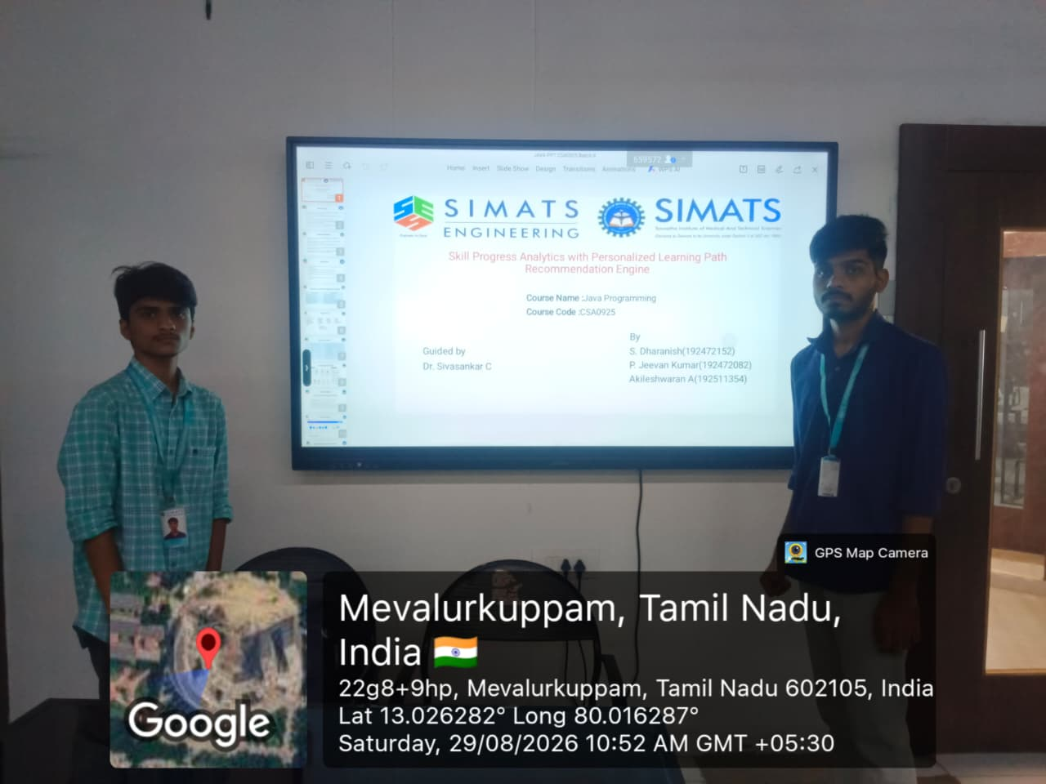
GEO TAG

Slide 21
THANK YOU

